Slide 1

SYNTHETIC FINANCIAL
DATA ANALYSIS
BY: GROWTH GURUS

Slide 2


1
Hello,
2
3
4
Meet Our Team
5
6
AKANSHA SHETTY
7
8
CHIMIRALA KOWSTUBHA
9
KAPAROTU VENKATA SURYA THARANI

Slide 3
TABLE OF CONTENT
1
2
3
01
05
Problem Statement
Insights
4
5
02
06
6
Objective
Challenges
7
03
07
8
Nature of dataset
Business Perspectives
9
04
08
Approach
Predictions

Slide 4



1
Problem
Statement
2
3
4
5
6
What insights can a synthetic financial dataset provide to identify informative features for fraud detection, and how can we use it to evaluate methods for achieving high accuracy?
7
8
9

Slide 5



NATURE OF DATASET
5
Synthetic financial dataset is artificially generated data that mimics real transactions.
This dataset contains historical records of financial activity potentially including fraudulent ones that occurred on January 1st, 2023 from 12:00 AM to 2:00 AM.
It includes details about
Transactions (ID, time, is fraudulent)
Customers (age, ID) & Merchants(ID)
Context (card type, location, purchase category)

Slide 6
OBJECTIVES
1
2
01
Segmenting customers by behavior, demographics, and preferences.
3
4
02
Analyzing customer segments to understand behavior and preferences.
5
6
03
Investigating correlations between customer segments and variables like fraud rates or transaction amounts.
7
8
04
Conducting customer segmentation analysis to categorize customers into groups based on demographics, transaction frequency, and purchase categories.
9

Slide 7
APPROACH
1
1
DATA PREPARATION
2
Preprocessed and standardized synthetic financial transaction data to ensure consistency and reliability in subsequent analyses.
3
EXPLORATORY ANALYSIS
4
2
To uncover patterns and relationships within the synthetic financial dataset, informing subsequent analytical approaches
5
DIAGNOSTIC ANALYSIS
6
3
Identifying anomalies,outliers in transaction data, aiding fraud detection and ensuring data quality for accurate analysis.
7
PREDICTIVE ANALYSIS
8
4
Forecast transaction amounts and enhance fraud detection in the financial dataset.
9
ACTIONABLE INSIGHTS
5
Derived actionable insights from the analysis to optimize fraud detection mechanisms and inform targeted marketing strategies, enhancing operational efficiency and customer satisfaction.

Slide 8





INSIGHTS
VISUALIZATION TECHNIQUES
1
2
BAR GRAPH
3
Facilitated comparison of transaction amount distributions across categories, aiding trend identification.
4
PIE CHART
5
Clarified the proportion of fraudulent transactions, enhancing understanding of fraud incidence rates and patterns.tes and patterns.
6
DONUT CHART
7
Offered insight into spending patterns by presenting transaction category breakdown.
8
HEATMAPS
9
Explored correlations like merchant category vs. hour, unveiling potential patterns.
HISTOGRAMS
Visualized transaction frequency over time, revealing peak periods and activity fluctuations.

Slide 9
INSIGHTS
1
2
Transaction amounts vary widely, indicating diverse spending behaviors among customers.
3
4
Certain merchants or transaction types exhibit irregular patterns, warranting further investigation for fraud detection purposes.
5
I N F E R E N C E S
6
Analysis of customer behaviors, including preferred card types and frequently chosen purchase categories.
7
Unveiling correlations between customer age, spending, and fraud occurrence, highlighting targeted transaction types and vulnerable demographics.
8
9
Exploration of spatial patterns in card types and fraud occurrences, pinpointing the most targeted cards and the demographics most affected by attacks.

Slide 10
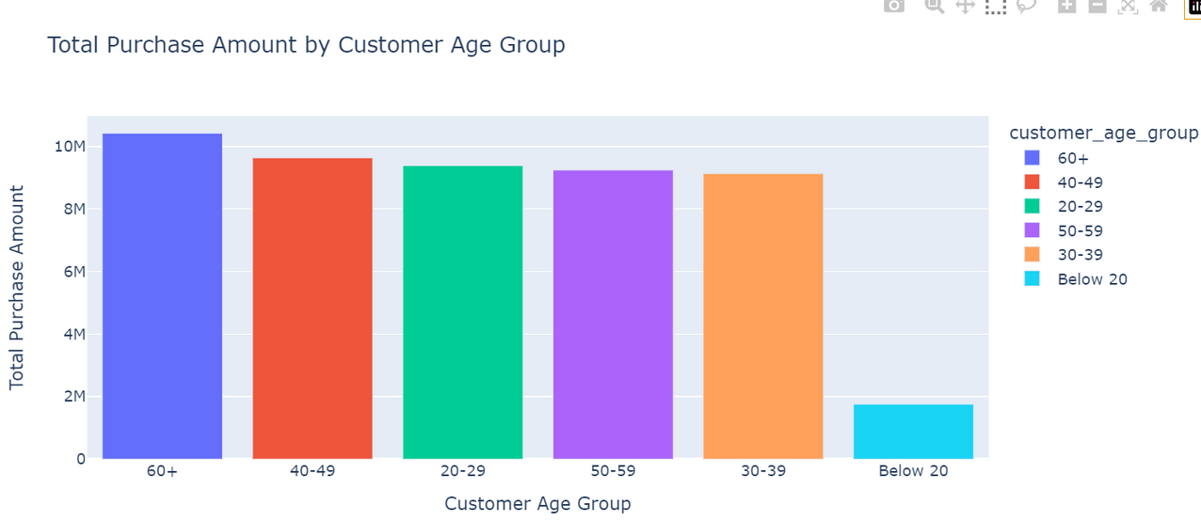
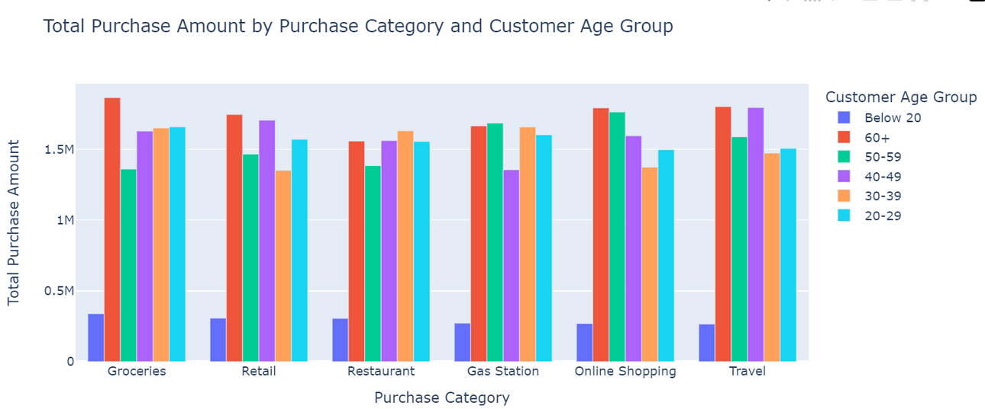
Transaction amounts vary widely, indicating diverse spending behaviors among customers.
1
2
3
4
5
6
7
8
9

Slide 11
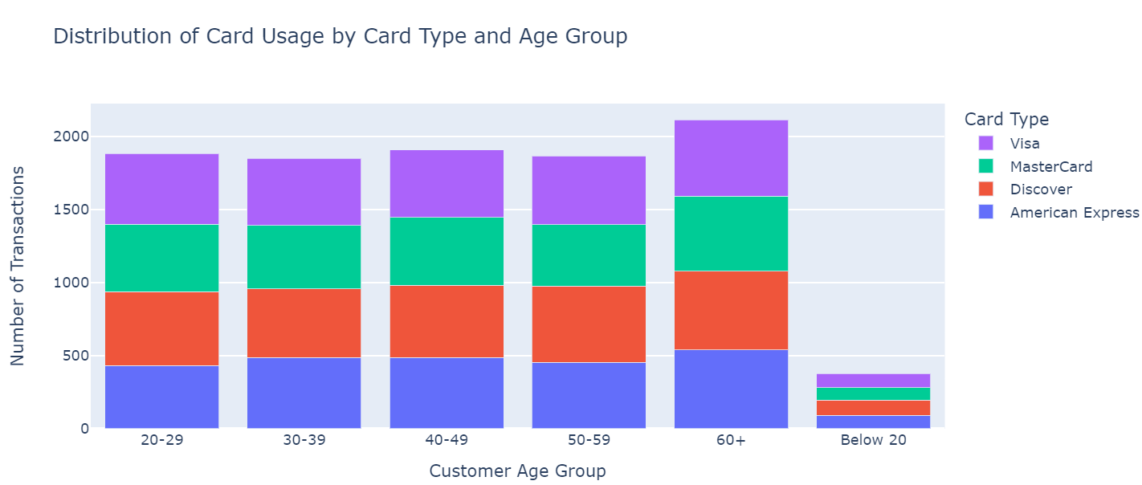
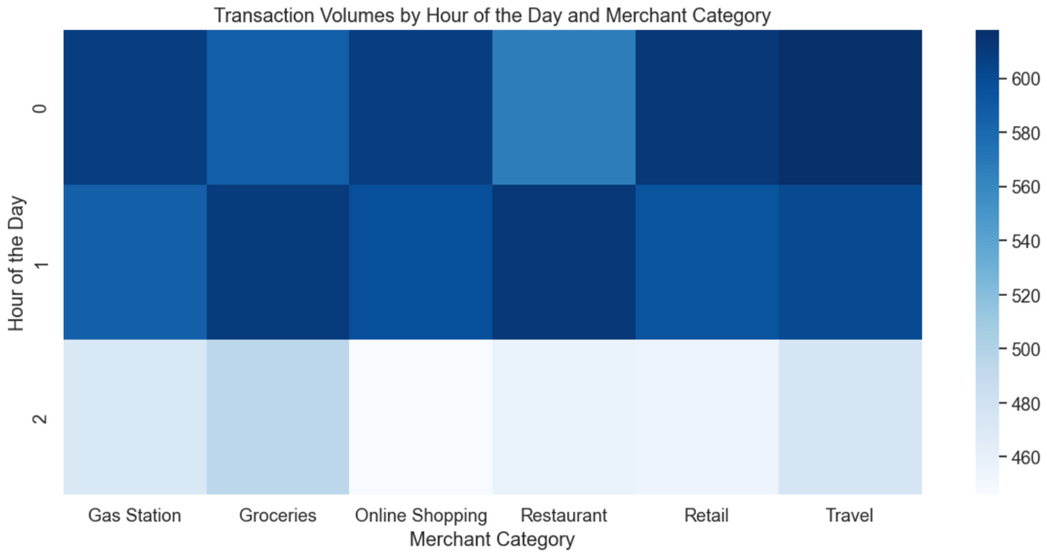
Analysis of customer behaviors, including preferred card types and frequently chosen purchase categories.
1
2
3
4
5
6
7
8
9

Slide 12
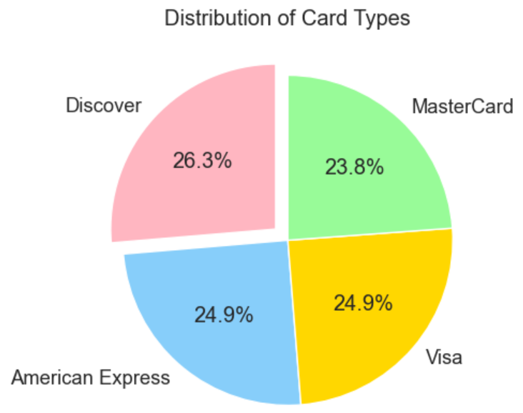
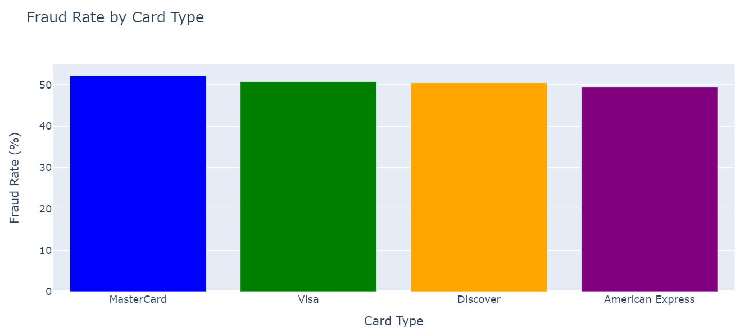
Exploration of spatial patterns in card types and fraud occurrences, pinpointing the most targeted cards and the demographics most affected by attacks.
1
2
3
4
5
6
7
8
9

Slide 13






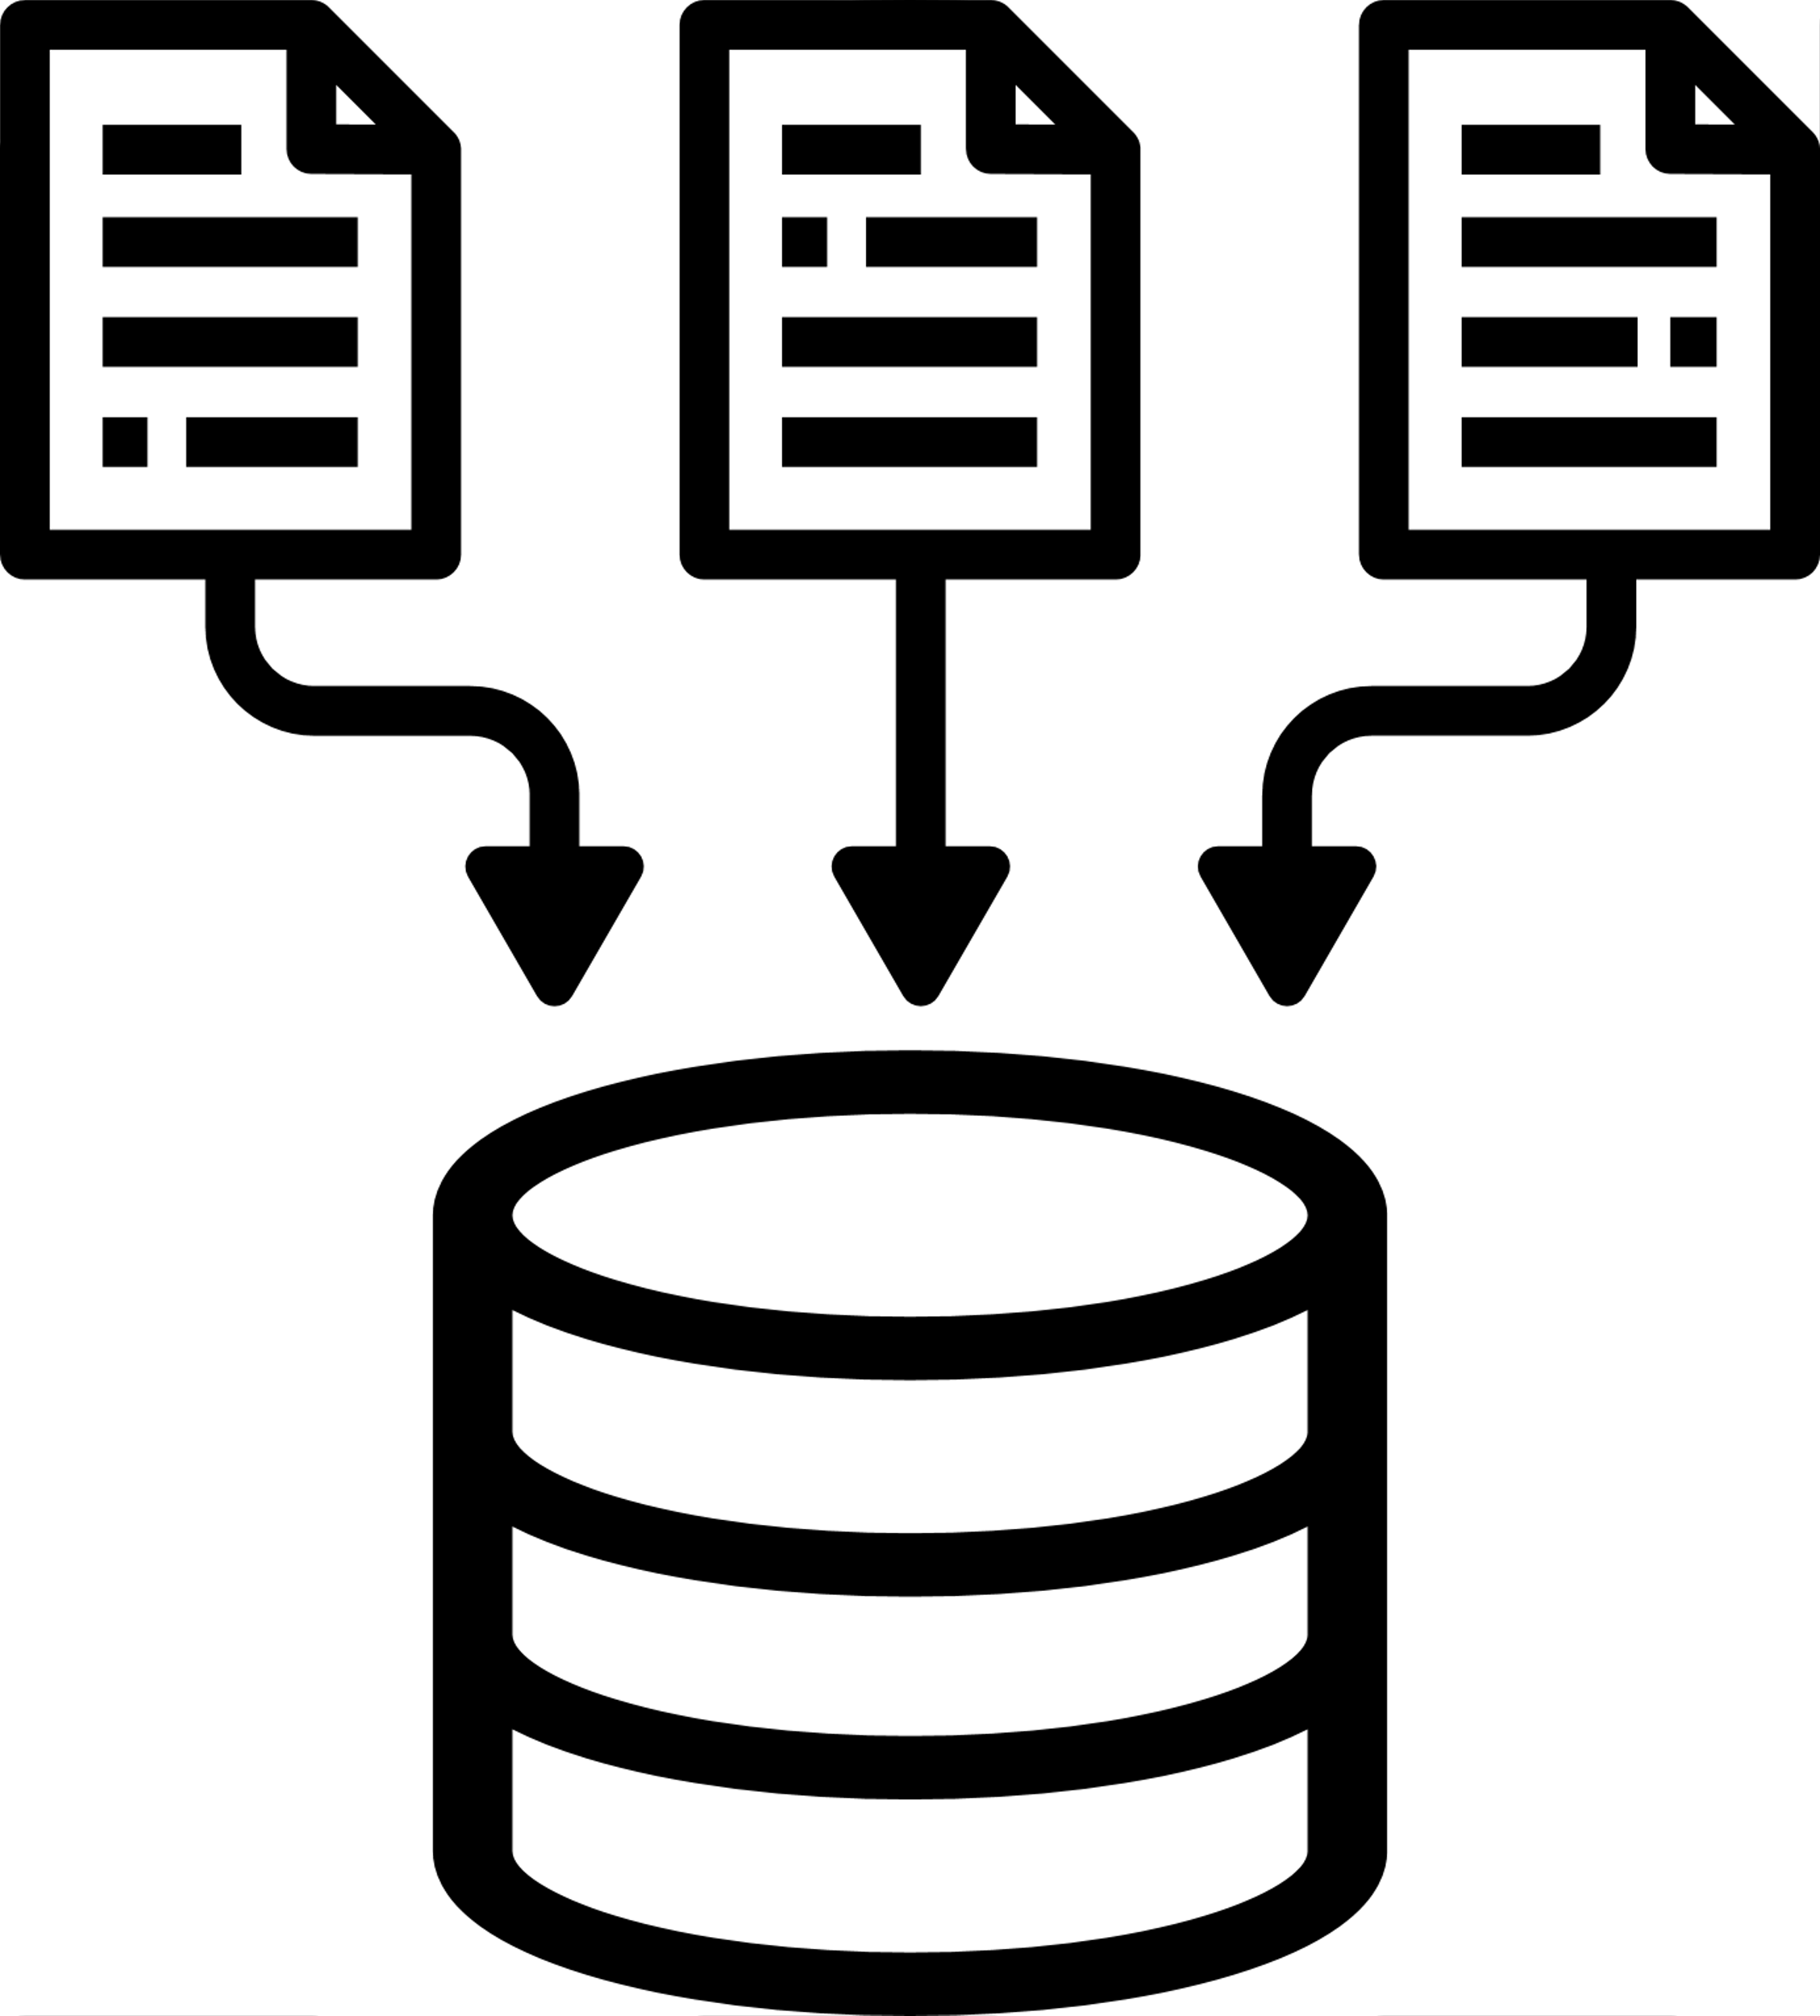

8
CHALLENGES
Transaction time analysis
Network Analysis
Data Visualization
Data Volume
Predictive Analysis

Slide 14

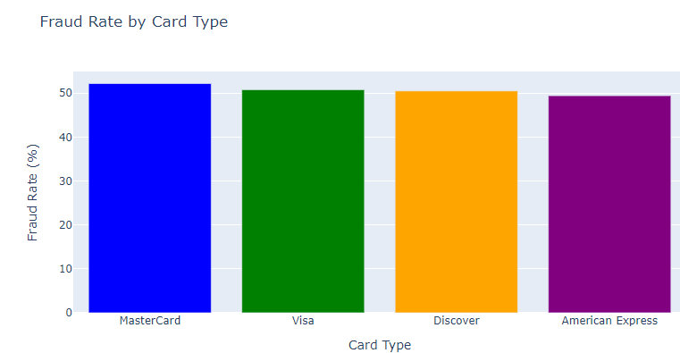
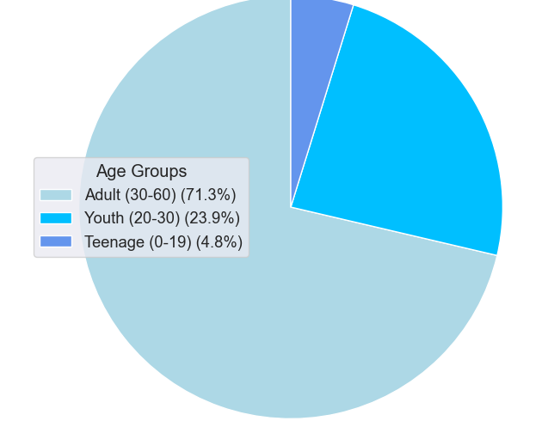
01
02
B U S I N E S S
P E R S P E C T I V E

Slide 15
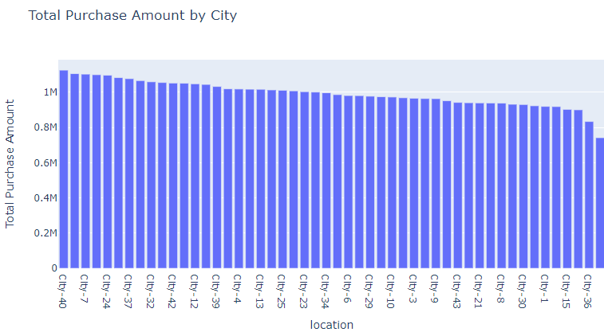
03
B U S I N E S S
P E R S P E C T I V E

Slide 16




10
PREDICTIONS
The anticipated trends or future developments in fraud prevention and fraudulent activities within the realm of financial transactions and card usage.
Rise of Account Takeover (ATO) Fraud
Fraud Prevention Software
Rise of Visa Card Fraud as a Service (FaaS):
Fraudsters offer online tools for Visa card fraud, facilitating unauthorized transactions.
Involves criminals gaining unauthorized access to user accounts due to increasing population.
Increased Fraud Prevention Measures
for High-Risk Card Types
KPI # 1

Slide 17

1
THANK
YOU
2
3
4
5
6
7
8
9
10
11

